Slide 1
Introduction to Spark Streaming

Slide 2
Properties of Streaming Applications
Unbounded stream of data entering and leaving
…..
…..
Often need to work with static data at the same time. E.g. join on static data
…..
…..
e.g. call records
E.g callers postcode

Slide 3
Definition of Stream Processing
Incremental processing of unbounded datasets
Incremental processing means we just look at the current data when updating the result.
We never need to look back at the previously processed data again.
So we only look at each data item once ever.
The data is unbounded meaning it just keeps on arriving.

Slide 4
Spark streaming is very popular!
“More than 50% of spark users say streaming is their most important application”
Tathagata Das (Lead developer of Spark streaming)

Slide 5
Six Common Use Cases of Spark Streaming
Notifications and alerting due to event
Some event occurs which triggers an alert
E.g. some event occurs which triggers an employee to move an item from one place in a warehouse to another.
Real-time reporting
Real-time dashboards

Slide 6
Six Common Use Cases of Spark Streaming
Incremental Extract, Transform and Load
E.g. take raw data stream and store in Parquet format to enable efficient querying from the latest data.
Update data to serve in real time
Usually two parts
Part 1: data is aggregated continuously with new data
E.g. continuously track the number of visits to a page
Part 2: users interactively query latest data
E.g. a web application queries the latest counts when a user requests it.
Real time decision making
Responding automatically to newly analyzed data
E.g. Bank automatically determines that new transaction maybe fraudulent

Slide 7
Six Common Use Cases of Spark Streaming
Online Machine Learning
Similar to real time decision making. But it requires the model to be first trained.
The data used for training can be a combination of historical and streaming data.
E.g. it can be a more sophisticated model that is used to predict whether there is credit card fraud.

Slide 8
Spark Streaming History
Spark streaming started in 2012
Started with the DStream API
Enable streaming using operators like map and reduce, etc.
Hundreds of organizations use it for processing Terabytes of data
First generation streaming using DStreams has some downsides
Uses relatively low level API similar to the RDD API
Hard for system to generate optimized code, hence slower
The API for batch and stream processing were similar but not the same
Hence when you want to convert a batch processing job to stream processing you would still need to rewrite all the code.

Slide 9
Structured Streaming
Recently structured streaming was developed.
Structured streaming allows you to use the same batch processing code as stream processing code.
Just like DataFrames and datasets, structured streaming API allows you to do declarative programming
You just specify what you want instead of how to do it.
The optimizer can make your code run faster.
Structured streaming runs super fast.
Unlike DStreams structured streaming also allows you to do event time processing. More on this later

Slide 10
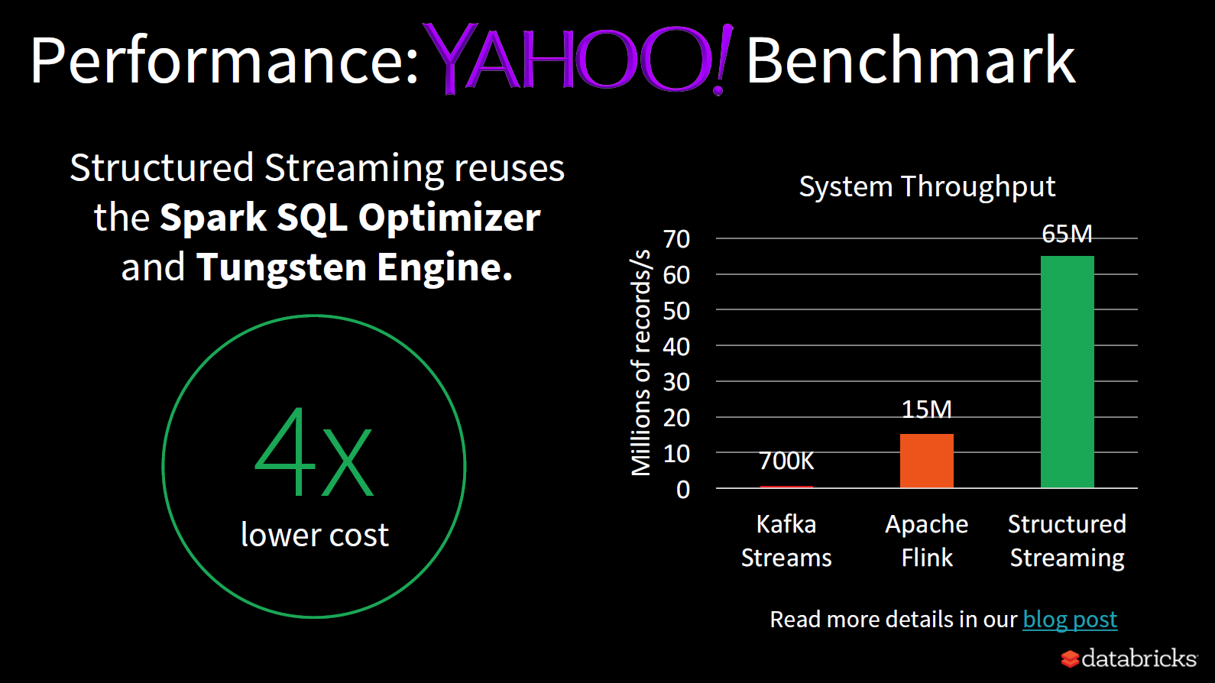

Slide 11
Record-at-a-time versus Declarative APIs
Systems like storm provide a record-at-a-time API
Pass each event to the application and let it react using custom code
This means it is up to the application to work out how to do things like what state to maintain, etc.
Structured streaming in Apache Spark allow users to just specify what they want using SQL and the system figures out how best to achieve it.
For example the system is the one which decides what state it needs to maintain.

Slide 12
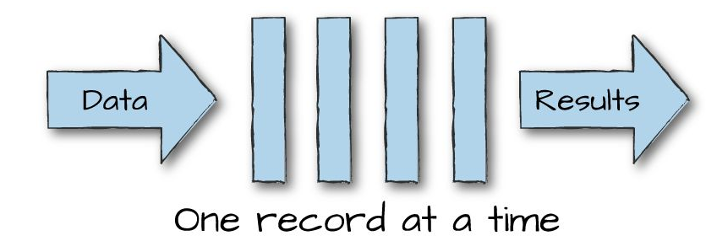
Continuous versus Micro-batch Execution
In continuous execution data is processed one record at a time.
This means each node in the system will continuously listen for messages from other nodes and process a record as soon as it becomes available.
The system offers low latency
Each record does not need to wait long for it to be processed
The system offers low bandwidth
The system is not as efficient since it can not do as much parallelism and hence can not process as much data per time period.

Slide 13
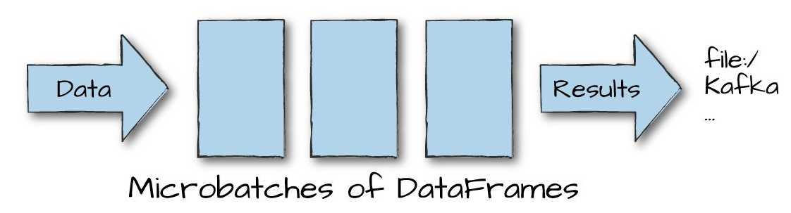
Continuous versus Micro-batch Execution
In micro batch execution data is processed one micro batch at a time.
The system offers higher latency
Need to wait for a micro-batch worth of data before processing begins.
The system offers high bandwidth
The system is able to process the data more efficiently since it can process all the data in the micro-batch in parallel.

Slide 14
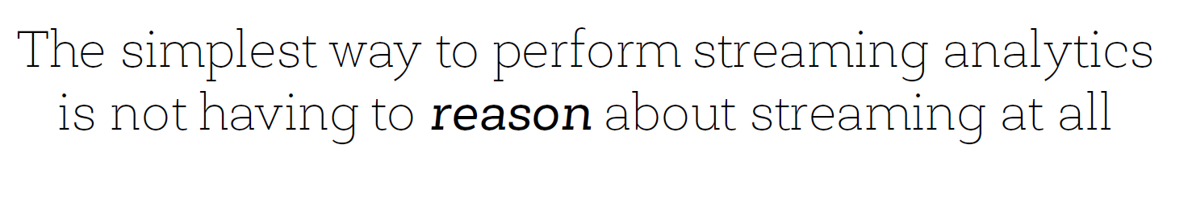
Just program like you would for batch processing. So all the logic is the same, but just replace a few commands to say the data coming in is from a streaming source and the output goes to some particular output sink.
Spark will work out the rest.

Slide 15
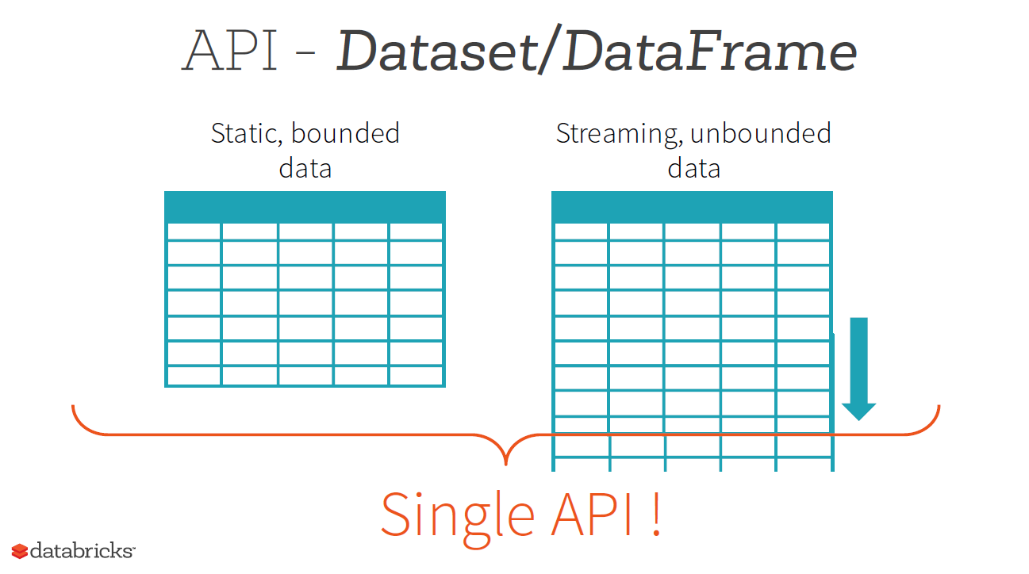
What is cool about Spark’s Structured streaming?
The same program that you write for batch processing works directly on streaming data!

Slide 16
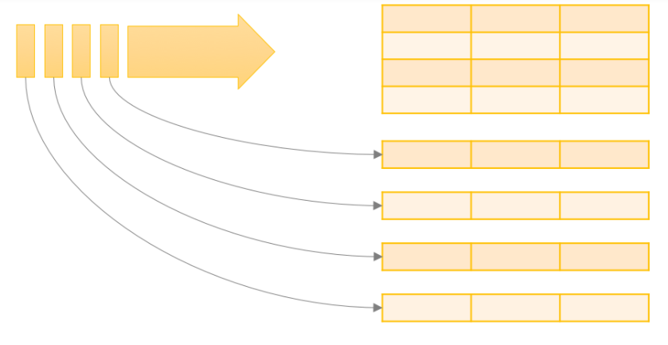
Structured Streaming (unbounded input table)
Unbounded input table
For structured streaming we can consider the input has coming from an unbounded input table
As more data tuples arrive in the stream they are considered as being pasted onto the end of the input table.

Slide 17
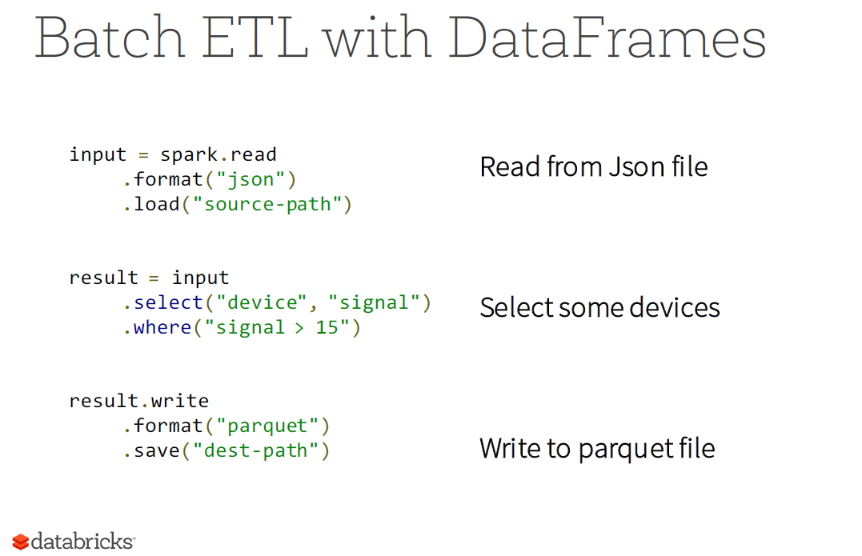

Slide 18
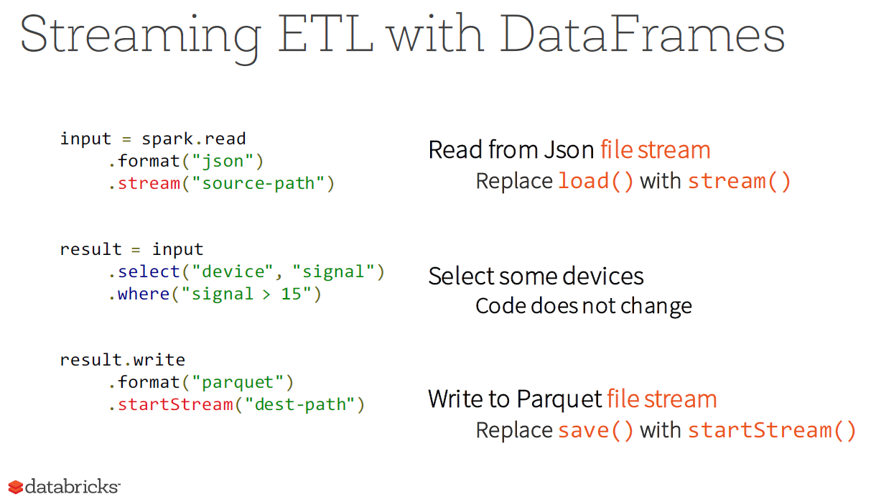

Slide 19
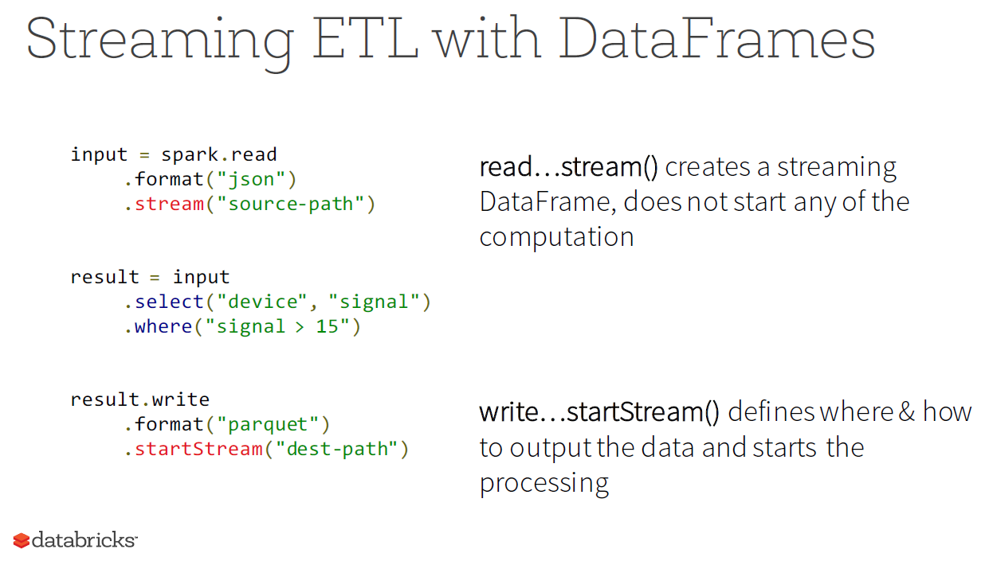

Slide 20
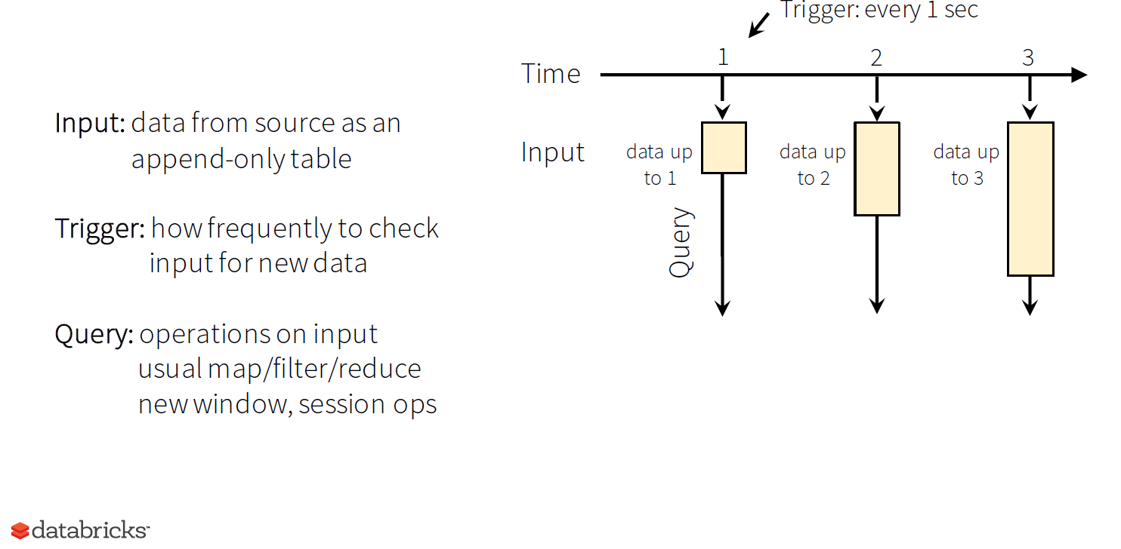
If trigger is not specified then Spark Streaming will trigger the start of the computation as soon as a microbatch of data is available. Setting a larger trigger interval can force the system to wait for a larger amount of data to arrive before doing the process and therefore process the data with more parallelism.

Slide 21
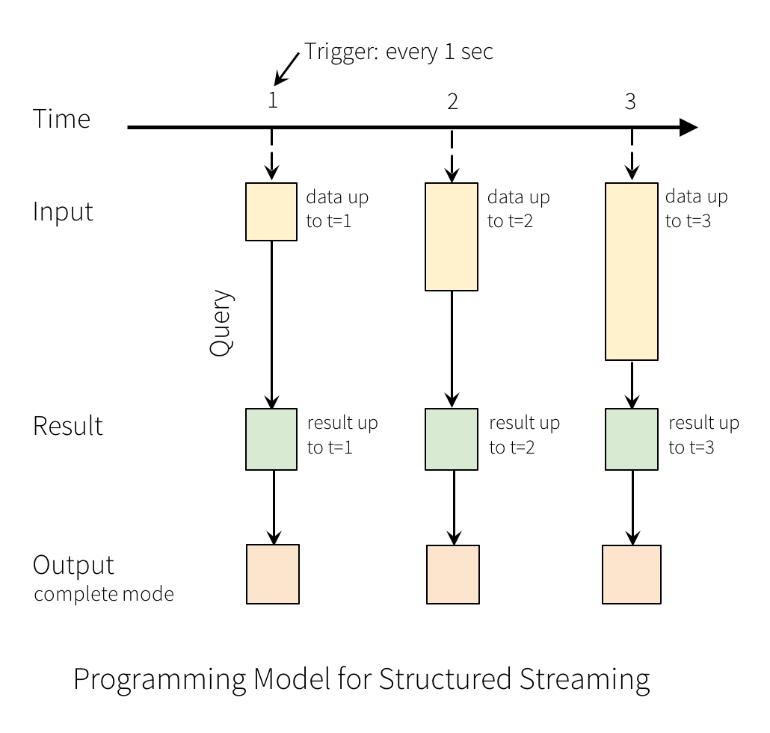
Generating the result
A query on the input will generate the “Result Table”.
Every trigger interval (say, every 1 second), new rows get appended to the Input Table, which eventually updates the Result Table.
Whenever the result table gets updated, we would want to write the changed result rows to an external sink (Output).

Slide 22
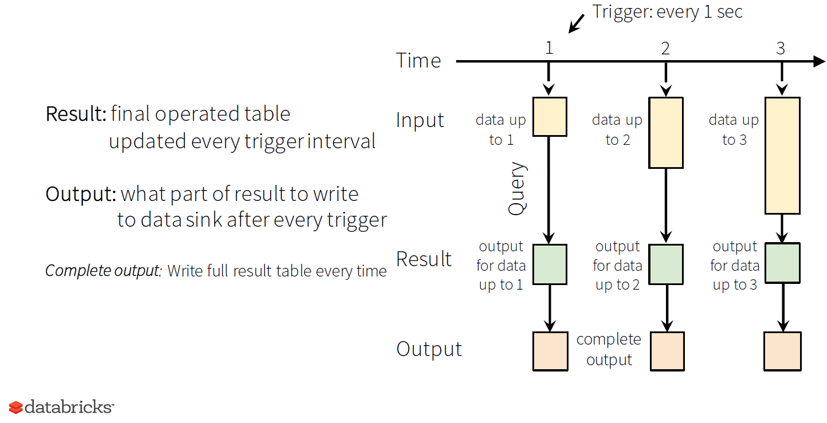
Output modes
Writing the complete output every time maybe useful when you are outputting sorted aggregated values:
E.g. the top 10 most twitted hashtag

Slide 23
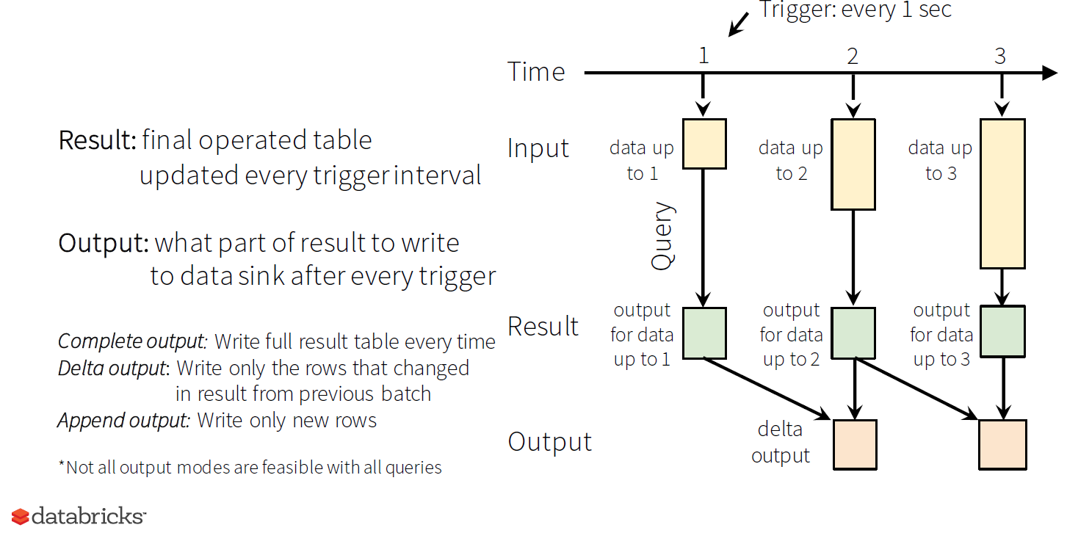
Output modes
Delta output is useful if you are only interested in seeing things that has changed since the previous batch.
Append output is often used for ETL workloads

Slide 24
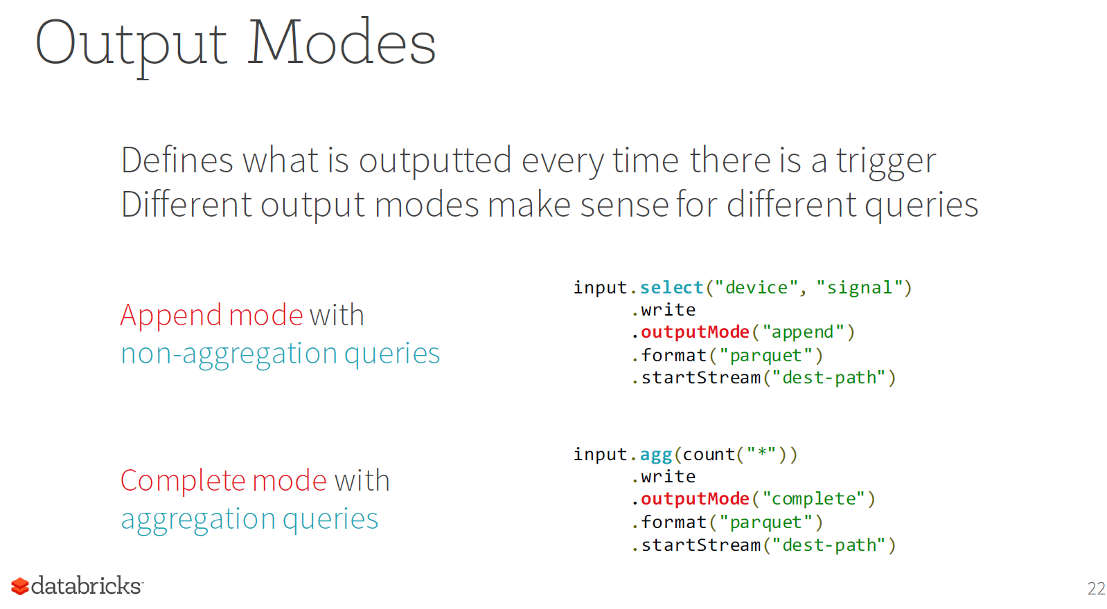

Slide 25
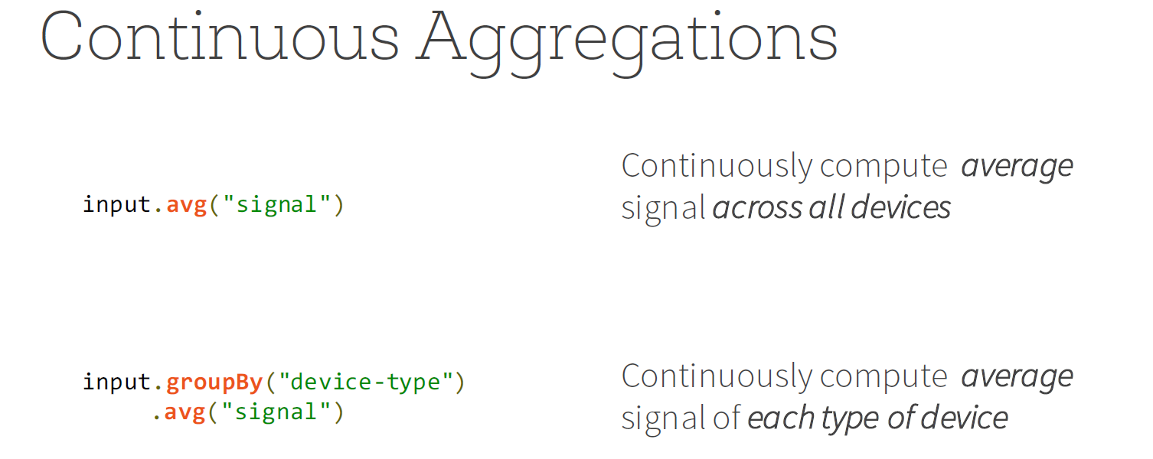
Note the above code is used for both micro-batching and continuous modes.
To distinguish micro-batch and continuous modes you use the trigger function.
…..writeStream().trigger(continuous = “5 seconds”) versus …..writeStream().trigger(“5 seconds”)
Continuous mode is only available in the Spark 2.3 or newer

Slide 26
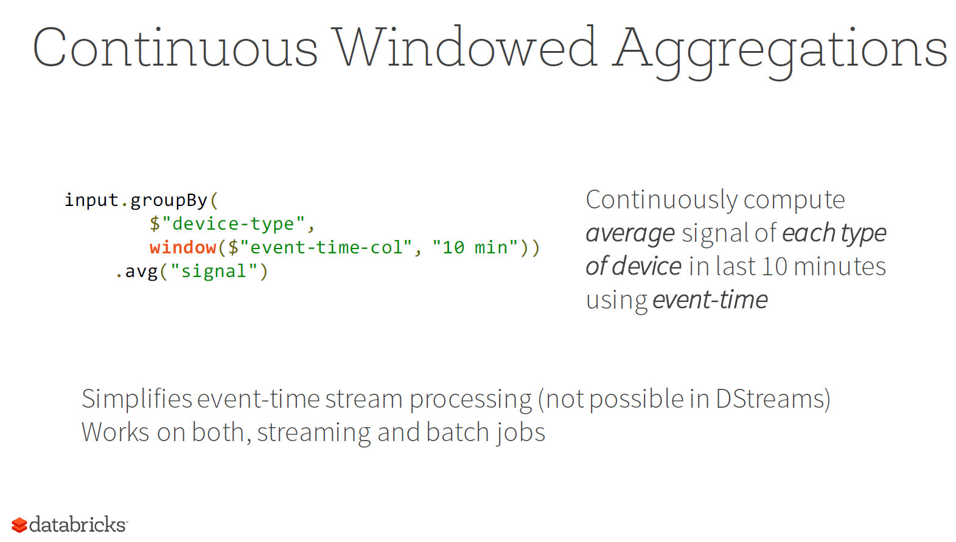

Slide 27
